Slide 1
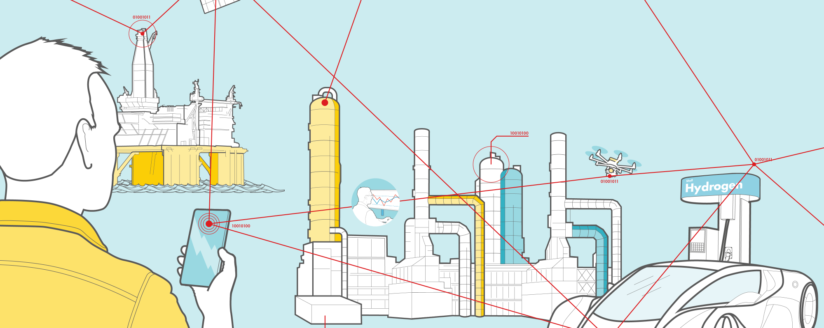
Test Strategy & Plan for CDM & Scheduling
Project Name : SLMT Orbital

Slide 2

Good Hygiene & Covid-19 Prevention
WHAT TO DO?
Regularly and thoroughly wash hands with Soap and water. Only use alcohol- based sanitizer if soap and water is not available.
Maintain at least 1 and half meters (5 feet)distance between yourself and anyone who is coughing or sneezing.
1
4
Cover your mouth and nose with your covered wrist or tissue when you cough or sneeze. Dispose of the used tissue immediately.
If you have travelled recently to a country with a COVID-19 outbreak in the last 14 days and you have a fever, cough, or breathing difficulties, please follow your local government advice.
2
5
3
Avoid touching your eyes, nose, or mouth
6
If you are feeling unwell then please do not come into work.
Daily updates on the Shell position are being posted on the Hub Health Alert.
7

Slide 3
Document control, Reviewers, Approvers and Sign off
Project Details
Project Name: SLMT Orbital | Modules: CDM(Commercial Data Modelling) and Scheduling
Sponsoring Business: Adam Grist | Date: 18-Jun-2022
Project Manager: Marlijn Boerma/Hiran | Project ID: PRJ0022860
Test Manager: Sapna Ranganath
Version Management
Increment | Scope
Version Number | 1.5
Draft/Final as of:
Printed on:
Author: | Vinayak Umadi/Chidambar Kulkarni
Owner: | Vinayak Umadi/Chidambar Kulkarni
Reviewers and Approvers
 | Name | Title | Date
Reviewed By
Reviewed By
Approved By
Approved By

Slide 4
Content
1. Document Purpose and Summary
2. Introduction of the Project SLMT Orbital
3. Business, Functional and Technical requirements
4. POC Technical Architecture of CDM and Scheduling modules
5. Test Approach
6. Test phase Definitions
7. Test Objectives
8. Test Case creation and Execution sequences
9. Roadmap and Scope
10. Test Estimations for CDM and Scheduling
11. Entry & Exit criteria of Test Phases
12. Test Monitoring/Metrics/Reporting
13. Test Tools and Automation Scope
14. Defect flow and Lifecycle
15. Enhancement OR Design change OR Change request
16. Assumptions, Constraints and dependencies
17. Test Environment Definitions
18. Risks and mitigation plan
19. Defect severity definitions
20. Revision History
21. Glossary
22. QA Standards & Best Practices
23. Test Case Creation Process & Best Practices

Slide 5
Document Purpose and Summary
As part of the PDF framework Test strategy and plan document is required to ensure testing is done with a right approach, right objectives aligned with expected requirements and be able to result a good quality application. This strategy and plan document is aligned to the result of Test decision tree assessment.
The purpose of this document is to define a Testing Strategy and plan for an Agile development life cycle. This document will define the standard deliverables and testing stages that are typically required for a development project and describes how these test stages will be used.
Agile (SCRUM) is the way of working where test and development are integrated in the development lifecycle
One release contain and number of sprints as agreed with product owner
Each sprint should deliver a working solution
Continuous testing during the application development lifecycle
Improved integration between End-Users and Development Team
More Unit test and Back-end Test compared to GUI tests.
Iterative deployment and testing.
More test automation and less manual testing.

Slide 6
Introduction and Overview of the Project SLMT Orbital
SLMT Orbital focuses on optimizing the SLMT portfolio
The Objective is to achieve a consistent view of the portfolio and facilitate an improved decision making supported by an integrated digital system.
The Project will be delivered on a module-by-module basis and is currently focused on below two modules
Commercial Data Modelling(CDM):
Creation of single source of truth for commercial data, making it available to other applications and core systems in a system processible way.
Scheduling:
Building a fit for purpose tool to build and manage the scheduling plan. This will be achieved by improving current 3D with additional commercial and operational constraints to reduce manual work, with improved user interface, analytical components and more integrated data inputs and output.

Slide 7
Business, Functional and Technical Requirements
Commercial Data Modelling for (CDM) and Scheduling:
Below is the share point of all functional specification documents → SLMT Orbital->General-Files->Documents->General-Testing and QA->All CDM & Scheduling Requirement Documents
The attached sheet composed with all links →

Slide 8
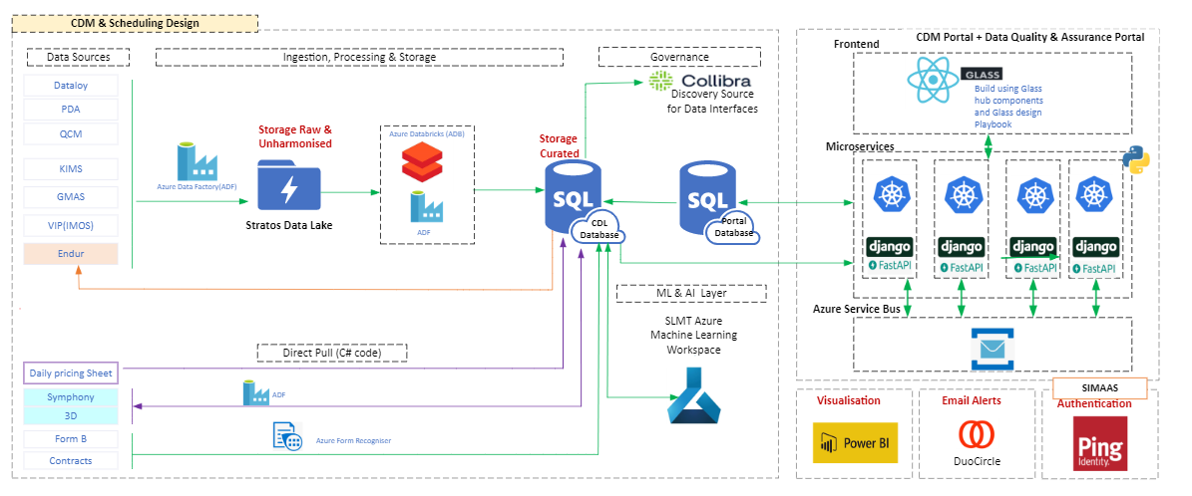
POC Technical Architecture of CDM and Scheduling modules
Architecture link here

Slide 9
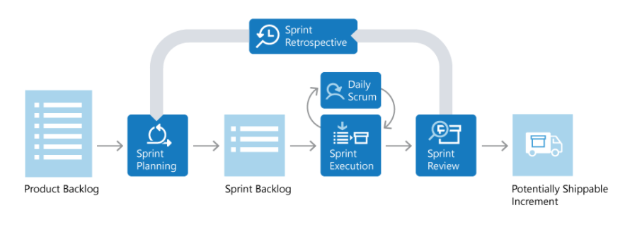
Test Approach
Testing will follow a risk-based approach that is aligned to the needs of the project. “Risk based approach” for defining level and scope of testing as well as “Pragmatic approach” for test automation.
Testing will be done manual as well automated way depending on the feasibility, execution sequence and other slides defined in this document.

Slide 10
Test phase Definitions
Testing Types planned
Sanity/Smoke Testing: Performed based on critical functionalities of CDM and Scheduling modules which verifies and confirms stability of the provided solution and applications of initial build and whenever a new build. Applicable Test cases and Test data will be created, selected and executed from the System test case suite.
SIT Testing: Involves all interfaces, systems and subsystems of CDM and Scheduling. This verifies and confirms overall integrated functionality with end-to-end flow. Applicable Test cases and Test data will be created, selected and executed accordingly.
Regression Testing: Performed after SIT testing once the code is fixed with SIT defects or update or change in code base. This verifies and confirms overall integrated functionality with end-to-end flow with no change in required functionality or no deviation from the required flow.
ITAS Testing (understand application is implemented with ITAS): Need to find out POC, get the set of requirements and timelines.
Security Testing: (Penetration testing and code scanning Testing). Performed by IRM team. Need to work to find out the support IRM team may required.
Performance Testing: Basic checks will be performed by manual and automation tester. This will not be formal/typical performance testing with usage of a tool. If standard performance testing has to be conducted, support from Test FE team required. Heads-up to be given to FE team with RPLN in Service Now.
User Acceptance Testing: Performed by Business user. QA team provides the support for all testing activities.

Slide 11
Test Objectives
CDM (Commercial Data Modeling) and Scheduling:
ETL Block
1) Compare and validate migration files & data for each table loaded from Data Sources Daily pricing Sheet, Symphony, 3D, Form B, Contracts i.e., Source Data to CDL Database on SLMT Azure SQL Database i.e., Target Data at TEST env.
Validate number of records(rows) and columns of all tables for each application of Source Data and Target Data are equal.
Each application tables and each rows data from each tables will be considered for comparisons and validations.
2) Compare and validate migration files & data for each table loaded from Data Sources Dataloy, PDA, QCM, KIMS, GMAS, VIP(IMQS) i.e., Source Data to CDL Database on SLMT Azure SQL Database i.e., Target Data at TEST/QA env.
Validate number of records(rows) and columns of all tables for each application of Source Data and Target Data are equal.
Each application tables and each rows data from each tables will be considered for comparisons and validations.
API (Microservices) Block
Validate functionality of each API of Microservices in compare with Portal Database – Data retrieval, Create New data, Update for existing data, Update for new data, Update with document, Delete existing data, Delete new data, validation of mandatory and non mandatory values.
Validate functionality of each API of Microservices in compare with CDL Database – Data retrieval, Create New data, Update for existing data, Update for new data, Update with document, Delete existing data, Delete new data, validation of mandatory and non mandatory values.

Slide 12
Test Objectives Contd...
Web UI Block (End to End Testing)
Accessibility of existing customer data search by customer number (or id) from Web UI–Navigation from Glass hub frontend web portal
Search customer by customer number (or id) get the customer details, compare and validate data against fetched data from Portal database.
Search customer by customer number (or id) get the customer details, compare and validate data against fetched data from CDL database.
Search with invalid customer data – all error messages.
Creating new customer data from Web UI–Navigation from Glass hub frontend web portal
Create new customer with all mandatory fields and validate data against fetched data from Portal database.
Validate all mandatory and non mandatory fields with its values.
Validate all error messages for mandatory and non mandatory fields.
3) Update existing customer from Web UI–Navigation from Glass hub frontend web portal
Update customer data with all mandatory fields and validate data against fetched data from Portal database.
Update customer data with all mandatory fields and validate data against fetched data from CDL database.
Validate all error messages for mandatory and non mandatory fields.
4) Update existing customer with new document from Web UI–Navigation from Glass hub frontend web portal
Update customer data with all mandatory fields and validate data against fetched data from Portal database.
Update customer data with all mandatory fields and validate data against fetched data from CDL database.
Validate all error messages for mandatory and non mandatory fields.
5) Update existing customer with from Web UI–Navigation from Glass hub frontend web portal

Slide 13
Test Case creation and Execution sequences
Test Cases creation:
All Test Cases will be designed and developed based on each Test Objectives and Approaches section provided in Test Plan and Strategy document. These Test cases will be created into Azure DevOps under related “Issue” of “Boards”. These can be accessed under “Test Plan” for execution and can be tracked under “Progress report”
Test Execution sequences:
SIT and Regression Testing for ETL Block: One cycle of System Integration Testing performed executing all Test cases manually covering all Test Objectives mentioned into ETL Block of Test Objectives slides. Next cycle will be of Regression test cycle Automated testing covering the Regression test suite and even covers the Test cases which covers the defect and its code fix.
Regression Test cases will be selected based on the defects fix and its functional impact.
SIT and Regression Testing for API (Microservices)Block: One cycle of System Integration Testing performed executing all Test cases manually covering all Test Objectives mentioned into API Block of Test Objectives slides. Next cycle will be of Regression test cycle Automated testing covering the Regression test suite and even covers the Test cases which covers the defect and its code fix.
Regression Test cases will be selected based on the defects fix and its functional impact.
Testing of GUI Block:
Sanity/Smoke Test: 2 cycle of Sanity/Smoke testing performed executing all test cases manually covering critical functionalities from SIT suit for CDM and Scheduling modules which verifies and confirms stability of the provided solution and applications.

Slide 14
Test Case creation and Execution sequences Contd…
Testing of GUI Block:
SIT: One cycle of System Integration Testing performed executing all Test cases manually covering all Test Objectives mentioned into Web UI Block of Test Objectives slides.
Regression Testing: Next cycle will be of Regression test cycle Automated testing covering the Regression test suite and even covers the Test cases which covers the defect and its code fix.
Regression Test cases will be selected based on the defects fix and its functional impact.
Security Testing: (Penetration testing and code scanning Testing). Performed by IRM team against specific and standard set of requirements.
ITAS Testing: ITAS testing performed manually based on test cases created on specific ITAS requirements mentioned into Web UI Block of Test Objectives slides.
Performance Testing: Basic performance checks will be performed by manual and automation tester mentioned into Web UI Block of Test Objectives slides.
UAT: One cycle of end-to-end testing covering execution of selected GUI Test Cases from SIT suit to make sure all intended functionality works comprehensively from the user’s eye.

Slide 15
Roadmap and Scope
CDM:
Roadmap: CDM Product Roadmap of Epics #1, #2 and #3
POC/MVP feature list and in scope: ADO Link
Sprint backlog items and scope is may get expanded based on user’s feedback.
Out of scope:
1. Endur /Other Source data validations
2. 3D tool
Scheduling:
Roadmap: Scheduling Product Roadmap of all planned Epics
POC/MVP feature list and in scope: ADO Link
Sprint backlog items and scope is may get expanded based on user’s feedback.
Out of scope:
1. Endur /Other Source data validations
2. 3D tool

Slide 16
Test Estimations for CDM and Scheduling for MVP/Epic or every Release
Key Activities | Planned Effort (in Weeks) | Remarks
REQ GATHERING, ANALYSIS & CLARIFICATIONS | 2 weeks
TEST STRATEGY & PLANNING | 1 week
TEST SCENARIOS & TEST CASE DESIGN - SIT | 2 weeks
TEST CASE – REVIEW, UPDATE AND APPROVAL | 1 week
TEST EXECUTION - MANUAL/AUTOMATION(SIT & REGRESSION) | 3 weeks
USER ACCEPTANCE TESTING | 2 weeks
TEST CLOSURE REPORT | 0.5 week
TEST CLOSURE – REVIEW & APPROVALS | 0.5 week
TOTAL EFFORT | 12 weeks
Note: 1) The above estimates are high level as per current MVP/Release requirements. There might be deviation of +/- 40%
2) Security, Performance and ITAS Testing effort is not included in this estimation.

Slide 17
Entry & Exit criteria of Test Phases
Test Phase (Test Type) | Entry Criteria | Exit Criteria | Responsible team
Unit Testing | Dev environment available. Completed code as per the acceptance criteria Completed test scripts | Unit Test scripts have been successfully executed and actual results documented. Identified defects have been fixed and retested Share open defects detail with test team | Development team
Sanity/Smoke Testing | Environments Availability Completed test scripts covering the main functionality/flows reviewed by BA or Design Architects | Smoke Test scripts have been successfully executed and actual results documented Identified defects have been fixed and retested | Testing Team
System Integration Testing (SIT) | Completed Unit Testing Code changes migrated to Integration test environments, Test environments are configured, and testers have necessary access Completed test scripts reviewed by BA or Design Architects and Test Data available Data seeding | Test scripts have been successfully executed and actual results documented. Identified defects have been either Fixed and retested or registered and signed off by Product Owner. No Severity 1 and 2 defects are open Test Report is shared with the stakeholders. | Testing Team

Slide 18
Entry & Exit criteria of Test Phases Contd...
Test Phase (Test Type) | Entry Criteria | Exit Criteria | Responsible team
Regression Testing | Completed SIT Completed test case which was indicated on the product backlog’s acceptance criteria is applicable for RT | Test scripts have been successfully executed and actual results documented. Identified defects have been either Fixed and retested or Registered and signed off by Product Owner No Severity 1 and 2 defects are open | Testing team
ITAS Testing | N/A | N/A | Testing team
Security Testing | N/A | N/A | IRM team Security testing is performed by Security/IRM team, but accountability lie with Test Lead/Test Manager

Slide 19
Entry & Exit criteria of Test Phases Contd...
Test Phase (Test Type) | Entry Criteria | Exit Criteria | Responsible (Which team is responsible for this phase)
Performance Testing | Completed system test Completed test case which was indicated on the product backlog’s acceptance criteria is applicable for RT Tool details –HP Load Runner, Dyna Trace /Jaws and etc. No Severity 1, 2 and 3 defects are open from SIT and Regression | Test scripts have been successfully executed and actual results documented. Identified defects have been either Fixed and retested or Registered and signed off by Product Owner Test Report | FE-Testing@shell.com for performance Testing.
User Acceptance Testing | Completed Regression Test and system test Migrated code to the specified product test environments. Test exit report agreed from the previous testing No Severity 1, and 2 defects are open from SIT and Regression | Test scripts have been successfully executed and actual results documented. Identified defects have been either fixed and retested; or Registered and signed off by Product Owner. | Business user Team

Slide 20
Test Monitoring/Metrics/Reporting
Test Monitoring is an important activity to ensure the Project, Progress metrics of testing is being tracked and reported to leadership team and stakeholders.
Progress reports and Metrics would be created from the Azure DevOps tool from “Progress report” section. This contain number of Test Cases executed, Passed, Failed, Not executed, Defect raised, Defect retested and its related Test cases.
Progress reports will be generated at least once in a week. It also includes issues and showstoppers which could impact Test execution in any manner.

Slide 21
Test Tools and Automation Scope
Sl.no | Planned Test Block | Automation tool to be used | Short description
1 | ETL | Manual, Python | Data comparison and validation of source and target.
2 | API (Microservices) | Manual, Python | API testing for intended functionality
3 | Web UI | Manual, Python | Web UI testing for intended integrated functionality (End to end).
4 | Test Management | Azure DevOps (ADO) | Test case creation, Test data description, Execution, Defect management, Metrics and Report generations.

Slide 22
Defect flow and Lifecycle
Defects
Each incidents will be raised into Azure DevOps as “Bug”. These “Bugs” considered as Defects. It will have a record of creation, comments, execution, related Test Case to track and all other details about the defect. These can be accessed from “Work items” and “Sprints” by navigating past Sprints and “Current” sprints.
Each Bugs will be raised only by QA team incase of ETL, Sanity, SIT and Regression Testing however in case of UAT phase User (Product Owner-PO) can also raise the Bug in terms of usability perspective.
Statuses of defects – Sequential, aligned with Azure DevOps
New – QA/BA/PO create Bug in ADO, enter all details along with severity, steps to reproduce etc. and assign it to BA to validate against the Functional Specs and to “Approve”. During this process the BA will ensure the Bug is captured correctly and is in fact a Bug. If it is not part of the Functional Specs, it will be tagged as an enhancement and parked for prioritization.
Approved – Once approved it should be assigned to Dev Lead to work on or assign it to the appropriate developers
Committed – When in Dev is in progress the Bug will be set to a Committed state. If Dev require more info/details/steps this will be assigned back to the QA/BA/PO in a Committed state.
Resolved – Once development is complete the developer will set the state to Resolved and assign the Bug over to the BA/QA/PO to validate. After QA/BA/PO retest, if Dev don’t fix it properly or completely the Bug will be assigned back to the Dev in a Committed state.
Done – After QA/BA/PO retest if the Bug is resolved the QA/BA/PO will set the state to Done.
Removed – Dev or BA/BA/PO can change the state to Removed from New or Committed state if the Bug is improper or not valid with convincing justification along with Functional Spec definition.

Slide 23
Enhancement OR Design change OR Change request
The Enhancement can be defined as “If the Bugs description (related function) is not part of current Functional Specs or not covered, it would be considered for Enhancement or Change request or Design change. These Bugs will be tracked down from ADO tool, will be incorporated into Functional Specs and functionalities will be included into subsequent releases.
These Bugs will be decided and marked by BA based on coverage of current Functional Specs as per the Bugs workflow defined into next slide.

Slide 24
Defect flow and Lifecycle Contd…
1a
1
QA/PO logs Bug - New
BA marks for Enhancement if not part of FS
2
BA approves - Approved
3
BA assign to Dev lead - Committed
1b
3a
Discuss with tester, reject if not valid/duplicate - Removed
Need more info?
QA provides required info- Committed
4
Developer fix the Bug - Committed
5a
Reopen if not fixed properly/completely- Committed
5
Reassign to QA/PO - Resolved
6
Retest the Bug - Done
if fixed properly/completely

Slide 25
Assumptions, Constraints and dependencies
Assumption | Impact
All relevant documents (Architecture documents, Design documents, functional requirements, Technical requirements, Data flow documents and Test plan and strategy) will be signed off from product owner and other stake holders before the development and execution of test cases. Any additional change will go through project change request process. | Testing accuracy, test case design, test data, execution schedule, defects etc. might get deviated or might not go as per expected.
All signed off documents will be available on project shared folders/sites. Any review comments or changes in document will be informed/reviewed with QA team, other stake holders and implemented accordingly. | Testing accuracy, test case design, test data, execution schedule, defects etc. might get deviated or might not go as per expected.
Read and write access is given to required Systems and Software of Shell and Shell environments and full access to required Database for test user ids and QA resources. All user ids and passwords related to roles, security accesses, privileges, authentication and authorization are created and available for Testers. | Testing accuracy, test case design, test data, execution schedule, defects etc. might get deviated or might not go as per expected.
Testers and Developers will update Defect statuses into tool or agreed process on regular basis to make sure no gap on the defect workflow. | Testing accuracy, test case design, test data, execution schedule, defects etc. might get deviated or might not go as per expected.
All required Code/Configuration/System or Database setup will be available and applied to respective environments as per Testing schedule and timelines. | Testing accuracy, test case design, test data, execution schedule, defects etc. might get deviated or might not go as per expected.

Slide 26
Assumptions, Constraints and dependencies contd…
Assumption | Impact
Testing will be done on the solution provided in POC | Outcome will be assessed and the end solution could change accordingly if any change.
No formal Performance testing using any tool by QA team | QA team won’t be able to assess the performance of the applications, systems and provided solution.
Constraints | Impact
Only high-level /MVP requirement available at this moment | Might result in change in testing schedule and timelines.
Dependencies | Impact
Required environment, Test Data support, SQL Queries support, Web UI integration with back-end tables and environment configuration support from Dev team will be available during normal business hours. | Testing accuracy, test case design, test data, execution schedule, defects etc. might get deviated or might not go as per expected.
QA resources will be available as per QA estimation and timelines/schedule as agreed for the project. | Testing accuracy, test case design, test data, execution schedule, defects etc. might get deviated or might not go as per expected.

Slide 27
Test Environment Definitions
Environment | Purpose | Ownership
Sandbox | Isolated virtual machine in which potentially unsafe software code can execute without affecting network resources or local applications | Developers
Development | Develop the source code for a program or software product | Developers
Test/QA/UAT | Perform many forms of functional and non-functional testing/Allow the application's main users to test new features before they are pushed into the production environment | QA/BA
Staging | Replica of Development/Production environment, used to perform functional testing, cade and data test prior moving to Production | Developers
Production | Where the latest versions of software, products, or updates are pushed live to the intended users | Business

Slide 28
Risks and mitigation plan
Risk | Impact | Probability | Rating | Mitigation plan
Knowledge of the business application & its logic | This leads to ambiguity of the test objective. | Medium | Low | Responsible tester should have hands on and should have fully equipped with all required docs
Ambiguous and change of requirement | Coverage of test scenarios, testing and test schedule will get impacted and Test design rework | High | High | Requirement freeze should be planned and/or testing timelines should be extended. Requirement should be self explanatory, or the proper requirement should be provided
Proper knowledge on the functionality | Test scenarios slippage could result defect leakage | Medium | Medium | Test case review should be done by client or BA
Undedicated test environment | Testing couldn’t be performed, and it will impact on test schedule | Low | High | Stable test environment should be available
Test data management | Loss and integration of Data | Medium | Medium | Test Data Should be managed properly in agreed Database
Inadequate validation | Nefarious request traffic intervention and inadequate validation will certainly deliver you right into a hacker’s hands. | Medium | Medium | To safeguard the security of your APIs, validation of SSL certificates is always necessary

Slide 29
Risks and mitigation plan Contd…
Risk | Impact | Probability | Rating | Mitigation Strategy
Miscommunication | Impacts the test objectives | High | High | Collaboration and timely meetings should mitigate the communication risks
Unavailability of team | Impact the test schedule | Medium | Medium | Test schedule should be informed to the team. Resource back up should be available.

Slide 30
Defect severity definitions
Severity | Definition
Severity 1 – Critical | Majority or Important functionality is critically unavailable with no workaround, showstopper Defect. Or Any system, application, database is unavailable. Or Environment is unavailable. An immediate fix is needed.
Severity 2 – High | Functionality is not working but has a reasonable workaround. Cannot use any part of the system until the defect is fixed. Unable to proceed with test. The application (or system) may abend or hang repeatedly or there may be an unrecoverable data loss. An immediate fix is needed.
Severity 3 – Medium | Issues not part of regular business workflow or functionality unavailable but has a simple workaround. Can use the system but a by-pass may be required, or testing can proceed. Testing is severely restricted due to a defect encountered for which there is no acceptable circumvention. The application executes but wrong results are encountered, or defects are discovered which might significantly affect production operation. A fix is required in order to proceed with this function.
Severity 4 – Low | Cosmetic issues, warnings, or some and has isolated-low impact. No immediate impact to test. This could be an incorrectly spelled word or poorly worded error message. Discrepancies are found that are of an insignificant nature and do not affect satisfactory operation or usability of the product. Examples may include improper presentation of warnings, messages, prompts or minor functional deviations that can be easily avoided. Fixes should take place only after all severity 1 and 2 defects have been resolved.

Slide 31
Revision History
Date | Version | Author | Reviewed By | Change Description
28th Jan 2022 | 1.0 | Suganya Gandhi | None | Initiation draft
15th Sept 2022 | 1.1 | SuganyaGandhi/ Vinayak Umadi | None | QA Team discussions and updates
21st Oct 2022 | 1.4 | Chidambar Kulkarni | None | Content, Business, Functional and Technical Requirements, Test Approach, Test Objectives, Test Phases and most of the slides and its contents.
14th Dec 2022 | 1.5 | Chidambar Kulkarni | Franz, Kreston, Marlijn, and Anas | Based on review comments and latest work streams updates
6th Mar 2023 | 1.6 | Chidambar Kulkarni | Nancy, Karl, Adam | Defects flow changes

Slide 32
Glossary
CDM- Commercial Data Modeling
ADO- Azure Dev Ops
BA- Business Analyst
GUI - Graphical User Interface
QA - Quality Assurance
POC - Proof Of Concept
MVP - Minimum Viable Product
ETL - Extract Transformation and Loading
API - Application Programming Interface
SIT - System Integration Testing
TBD - To Be Discussed

Slide 33
QA Standards & Best Practices
All the test artifacts will be updated and maintained in Azure DevOps.
Test tool(s) has been provisioned and users have role-based access.
All the components must be completely developed/configured and deployed for test
Test Scripts have been created, reviewed and approved by BA’s and a peer review has been conducted and all comments, versions and approvals to have been logged
All the functional requirements are covered in the test scripts (RTM)
Project and Business focal points are available for support as required during test execution
The production environment is available to test the integration with other systems, along with the related software, data and connections configured (As required by the test level)
Test machines / functional accounts are available
Test plan and test cases have been signed off
Ensure all test scripts relevant to current test phase have been executed at least once. (Based on priority all Critical, High and Medium test cases have been 100% executed successfully)
Exceptions identified with clear plans to address during General Availability
Open Critical / High Priority defects have an agreed resolution and target date for fix.
Review and approval of the Test closure report by project stakeholders is must.
Test Standard, Guidelines and Templates: Refer the below SharePoint location for key test templates:
https://eu001sp.shell.com/sites/aaaaa7458/Test%20Standards%20Guidelines%20and%20Templates/Forms/DesignNewView.aspx

Slide 34
Test Case Creation Process & Best Practices
Requirement Gathering from Client/BA
Analyze the Requirements
Clear the Doubts/Clarifications on Requirements
Create the Test Scenarios and Categorize them as per Test Category i.e., Smoke/Sanity/Regression etc.
Peer reviews the test scripts
Update the test cases based on the Feedback
Share the Test Scenarios with BA for Review
Update/Add the test cases as per the review provided by the BAs/Client

